Slide 1


Slide 2
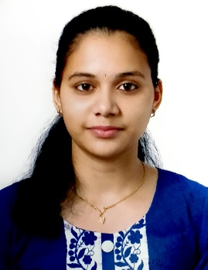
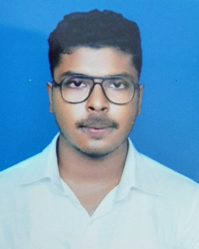
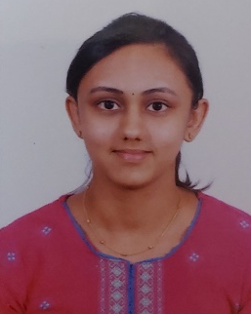
Project Highlights
Project Name : Netflix Database Management System
Team Size : 3
BU Mentor Name : Mentor PS#
Team Members Details (Professional Stamp Size Photo with few lines of individual briefing
Pratheeksha J
99002533
2009MYSSPSB1
B.E in Information Science and Engineering
C, C++, Java, MySQL
Abhay Kumar Dhar
99002515
2009MYSSPSB1
B.Tech- Computer Science and System Engineering
Java, C, C++, IoT
Sahana Rao PS
99002542
2009MYSSPSB1
B.E in Information Science and Engineering
C,C++, HTML , DBMS

Slide 3

Project Video Snippet

Slide 4
Future development that can be implemented further
To connect the backend to a proper database to hold large amount of data about series in Netflix
Create a feature to let the user also add details of new upcoming series in the website.
It can be further enhanced by adding attractive GUIs.

Slide 5


Thank You !

